Slide 1

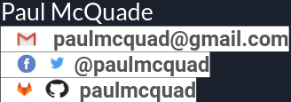
Learn Python in Jupyter Lab

Slide 2
Prerequisites
The following must be installed:
Python 3.8.5
Git 2.28 / GitHub or GitLab Account
JupyterLab 2.2.8
If not please install via Links:
https://www.python.org/downloads/
https://git-scm.com/downloads
https://jupyter.org/install.html
More info:
https://jupyter.org/
https://pypi.org/project/jupyterlab/
P.S:
I Used a package manager called Octopi on my Linux System but you can use brew on macOS.

Slide 3
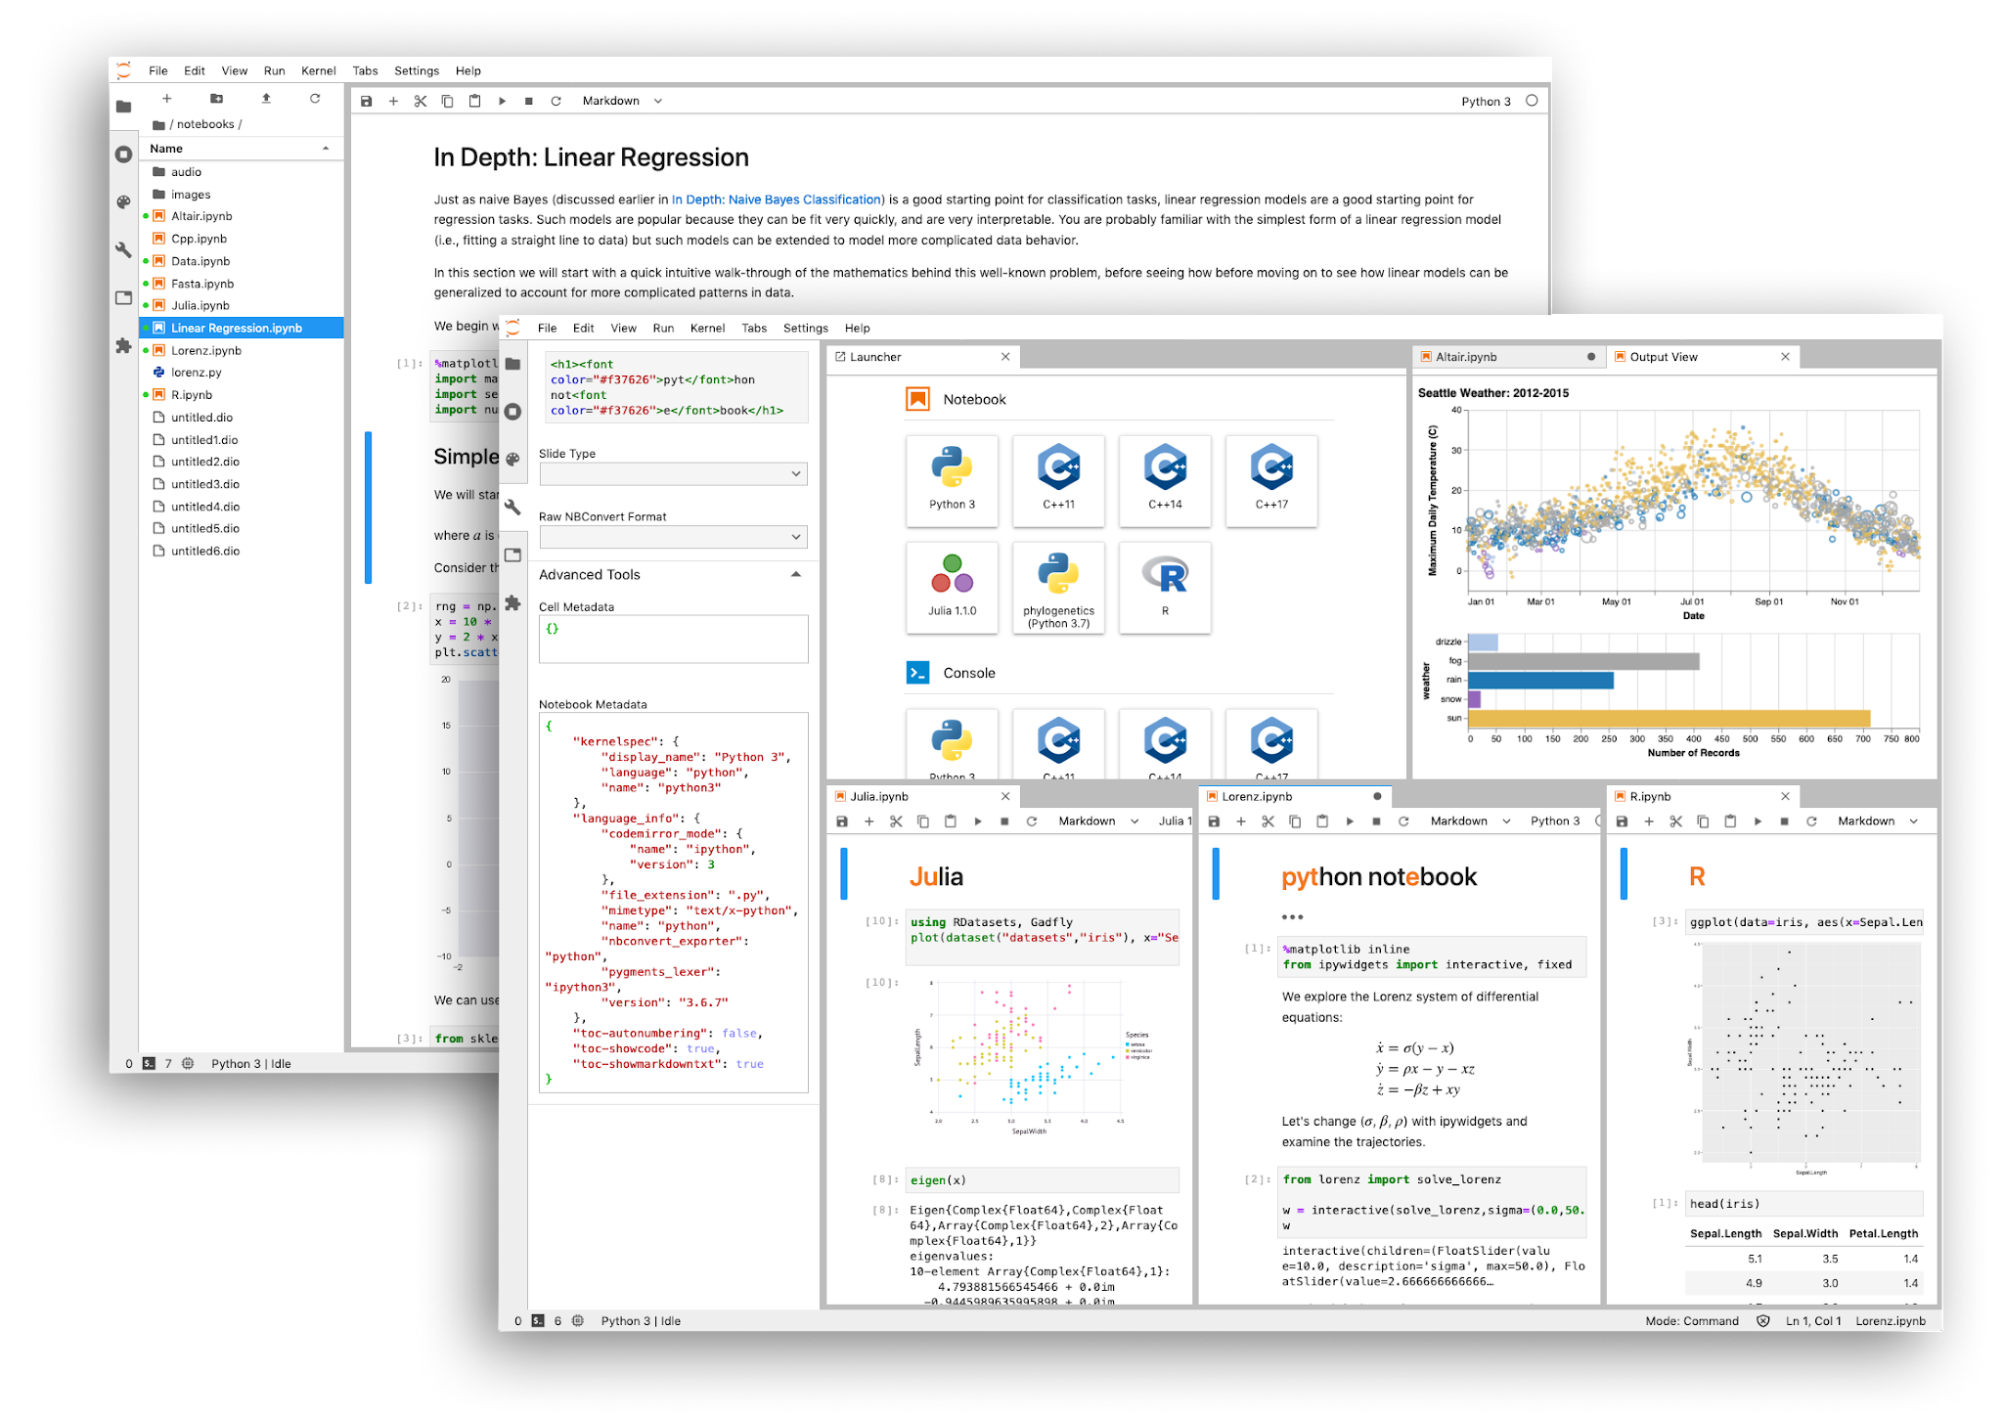
So What is JupyterLab?
JupyterLab is a web-based interactive development environment for Jupyter notebooks, code, and data. JupyterLab is flexible: configure and arrange the user interface to support a wide range of workflows in data science, scientific computing, and machine learning. JupyterLab is extensible and modular: write plugins that add new components and integrate with existing ones.

Slide 4
Python Modules/Packages for Data Science/ Machine Learning/Data Mining
Install to following packages - Use pip, conda or other package manager
Numpy - https://numpy.org/install/
Scipy - https://www.scipy.org/install.html
Pandas - https://pandas.pydata.org/getting_started.html
Scikit-Learn - https://scikit-learn.org/stable/install.html
Scikit-image - https://scikit-image.org/docs/stable/install.html
Matplotlib - https://matplotlib.org/users/installing.html
Pytorch - https://pytorch.org/
TensorFlow - https://www.tensorflow.org/
Scarpy - https://scrapy.org/
Beautiful Soup - https://www.crummy.com/software/BeautifulSoup/
Keras - https://keras.io/
Seaborn - https://seaborn.pydata.org/installing.html
Bokeh - https://bokeh.org/

Slide 5
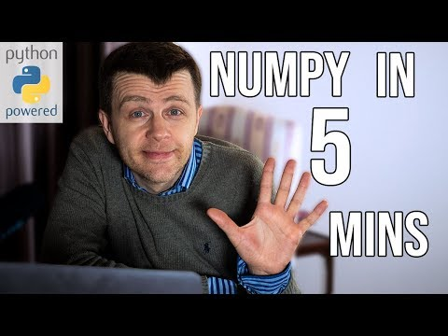
Youtube Numpy Video/ Github Link:
Code: https://github.com/paulmcquad/DataScience/

Slide 6
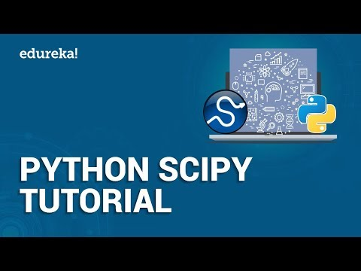
Youtube Scipy Video

Slide 7

Start your Data Science Portfolio
Join: https://www.kaggle.com/
Get a job: https://www.kaggle.com/jobs
Look @ other people's work: https://www.kaggle.com/notebooks
Look @ Datasets: https://www.kaggle.com/datasets
Follow people/Me: https://www.kaggle.com/paulmcquad

Slide 8
Thanks!
Any Questions and Hopefully Answers.
Link: https://github.com/paulmcquad/Talks

